Slide 1
Presentation by:
Assoc Prof Dr. Anees Janee Ali
Director of USM International Office
aneesali15@yahoo.com

Slide 2
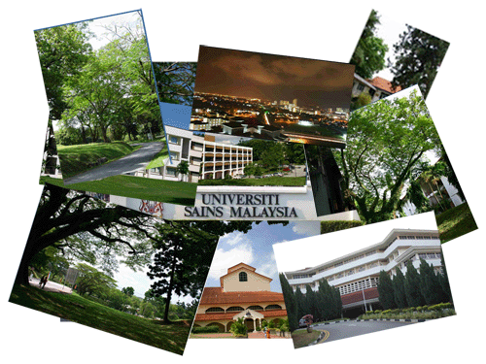
USM

Slide 3
WELCOME TO PENANG ISLAND

Slide 4
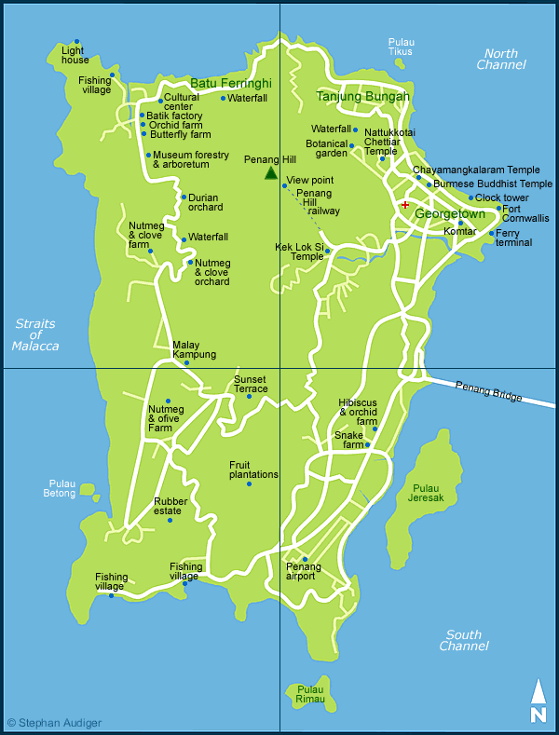
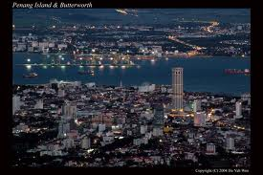
Where we are

Slide 5
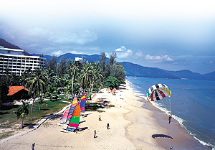
Penang Tourist Attractions
Penang Bridge
Batu Ferringhi Beach
Kek Loksi Temple

Slide 6
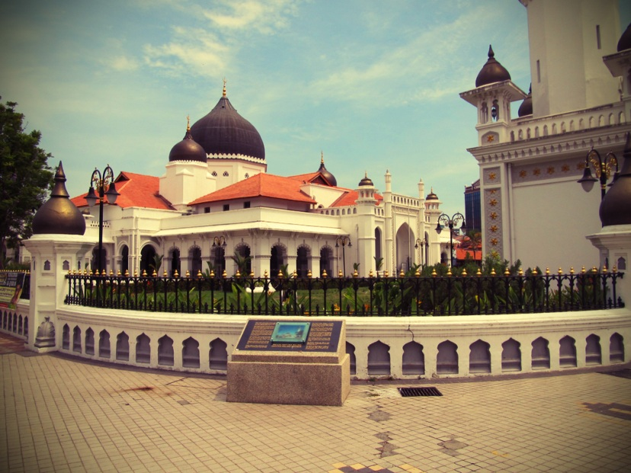
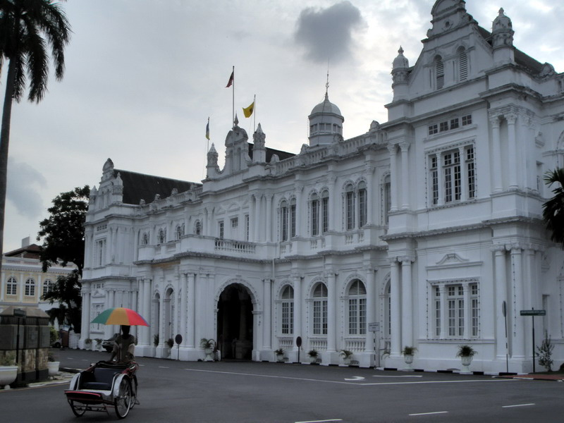
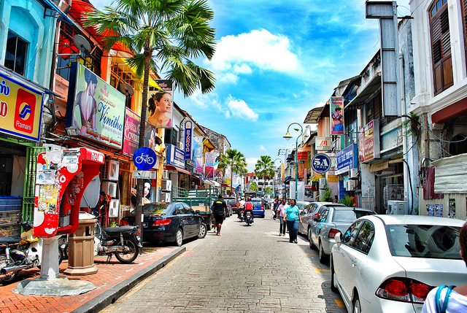
Penang World's Heritage City by UNESCO (2010)
Kapitan Keling Mosque
Penang Municipal Council
Little India

Slide 7
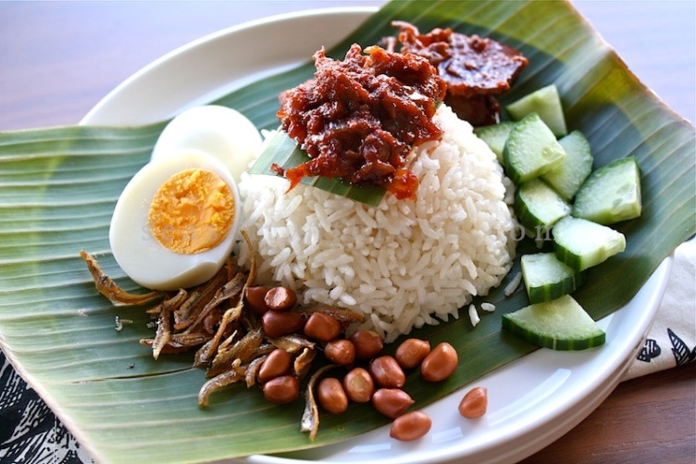
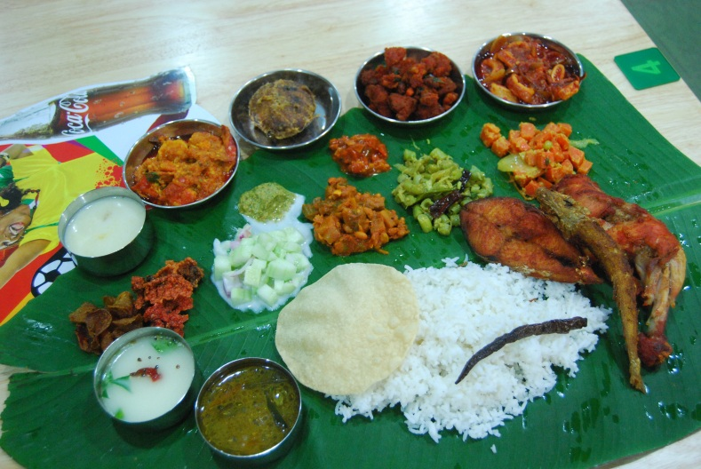
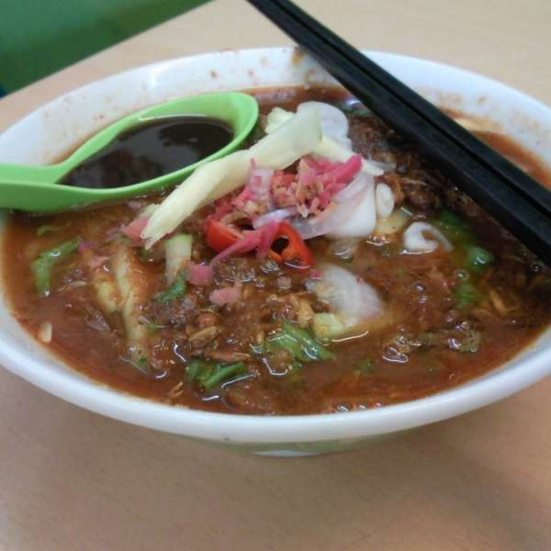
Penang Local Cuisine
Nasi Lemak
Banana Leaf
Laksa
Malay Cuisine
Indian Cuisine
Indian Cuisine
Chinese Cuisine

Slide 8
Background of USM
Established 1969 as the second university in Malaysia
Started with the enrolment of 57 students
Currently, USM offers courses at undergraduate and postgraduate levels to approximately 24,000 students plus 8000 students under the long distance learning programme
2500 international students with more than 60 nationalities
Since September 2008 USM has been assigned as Accelerated Programme for Excellence (APEX) university

Slide 9
Program Outline (Main Campus)
Pure Arts
Centre for Policy Research and International Studies
School of Distance Education
School of Humanities
School of Languages, Literacies and Translation
School of Social Sciences
Applied Arts
Centre for Global Archaeological Research
Centre for Instructional Technology and Multimedia
Graduate School of Business (GSB)
School of Communication
School of Educational Studies
School of Management
School of The Arts
Women’s Development Research Centre
Pure Science
Centre for Chemical Biology
Centre for Marine and Coastal Studies
School of Biology Sciences
School of Chemical Sciences
School of Distance Education
School of Mathematical Sciences
School of Physics
Applied Science
Centre for Drug Research
Malaysian Institute of Pharmaceuticals & Nutraceuticals
National Advanced IPV6 Centre
National Poison Centre
School of Computer Sciences
School of Housing, Building and Planning
School of Industrial Technology
School of Pharmaceutical Sciences

Slide 10
Engineering & Health Campus
River Engineering & Urban Drainage Research Centre
School of Aerospace Engineering
School of Chemical Engineering
School of Civil Engineering
School of Electrical & Electronic Engineering
School of Materials & Minerals Resources Engineering
School of Mechanical Engineering
Advanced Medical & Dental Institute
Institute for Research In Molecular Medicine
School of Dental Sciences
School of Health Sciences
School of Medical Sciences

Slide 11
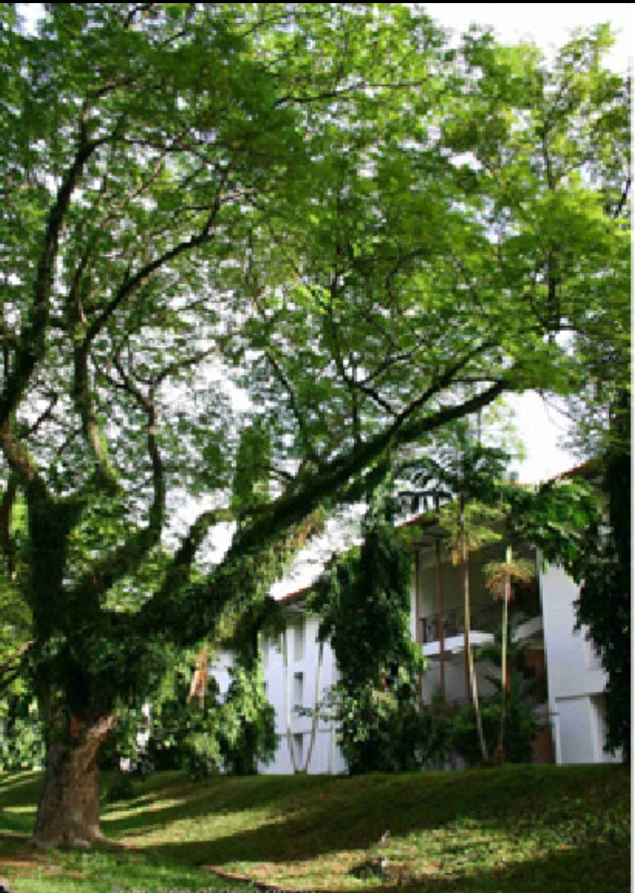
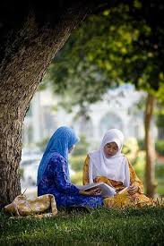
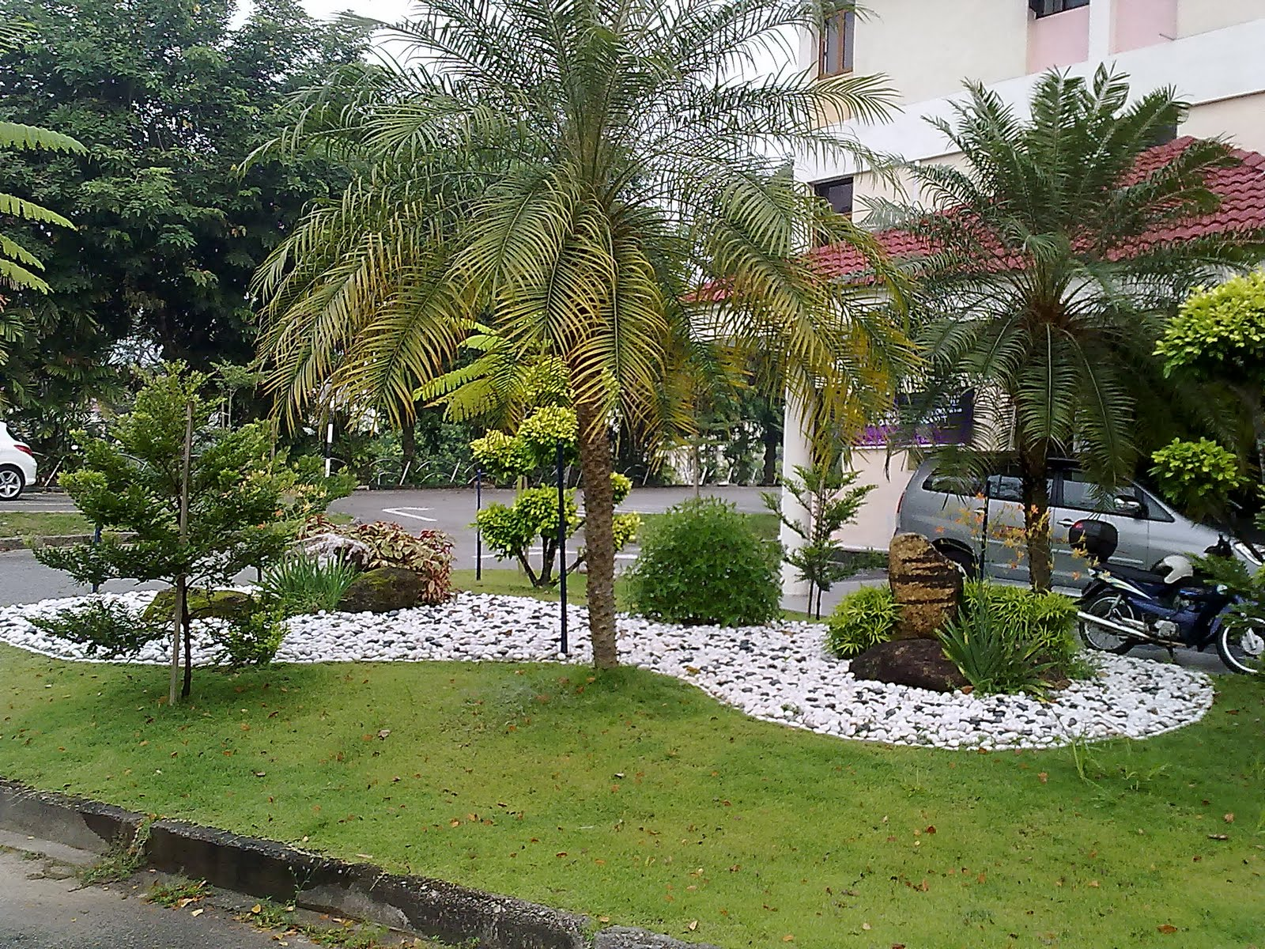
The University in a Garden
The University in a Garden concept as conceptualized by USM is designed to depict the close affinity between its role and function as an institution of higher learning and nature amidst a garden setting

Slide 12
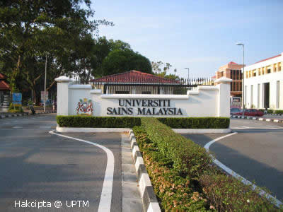
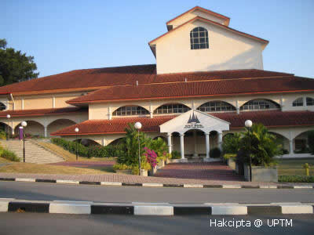
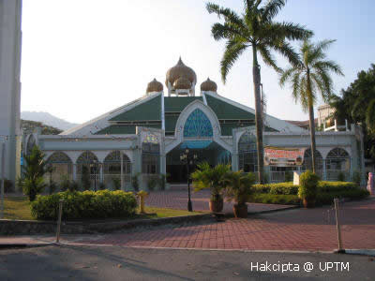
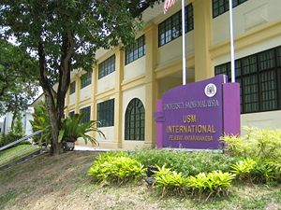
USM MAIN CAMPUS
USM Main Entrance
Dewan Budaya
USM Mosque
USM International Office

Slide 13
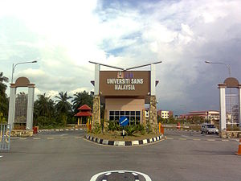
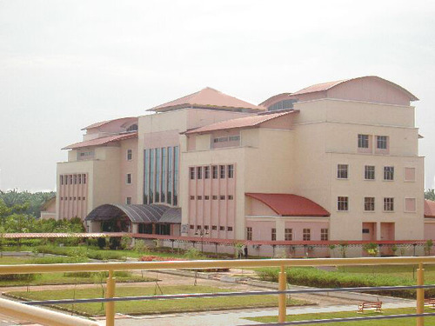
Engineering Campus

Slide 14
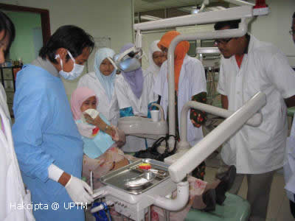
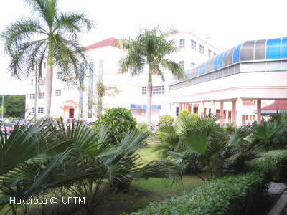
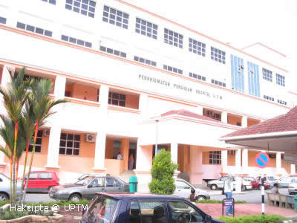
Health Campus (Kubang Kerian)

Slide 15
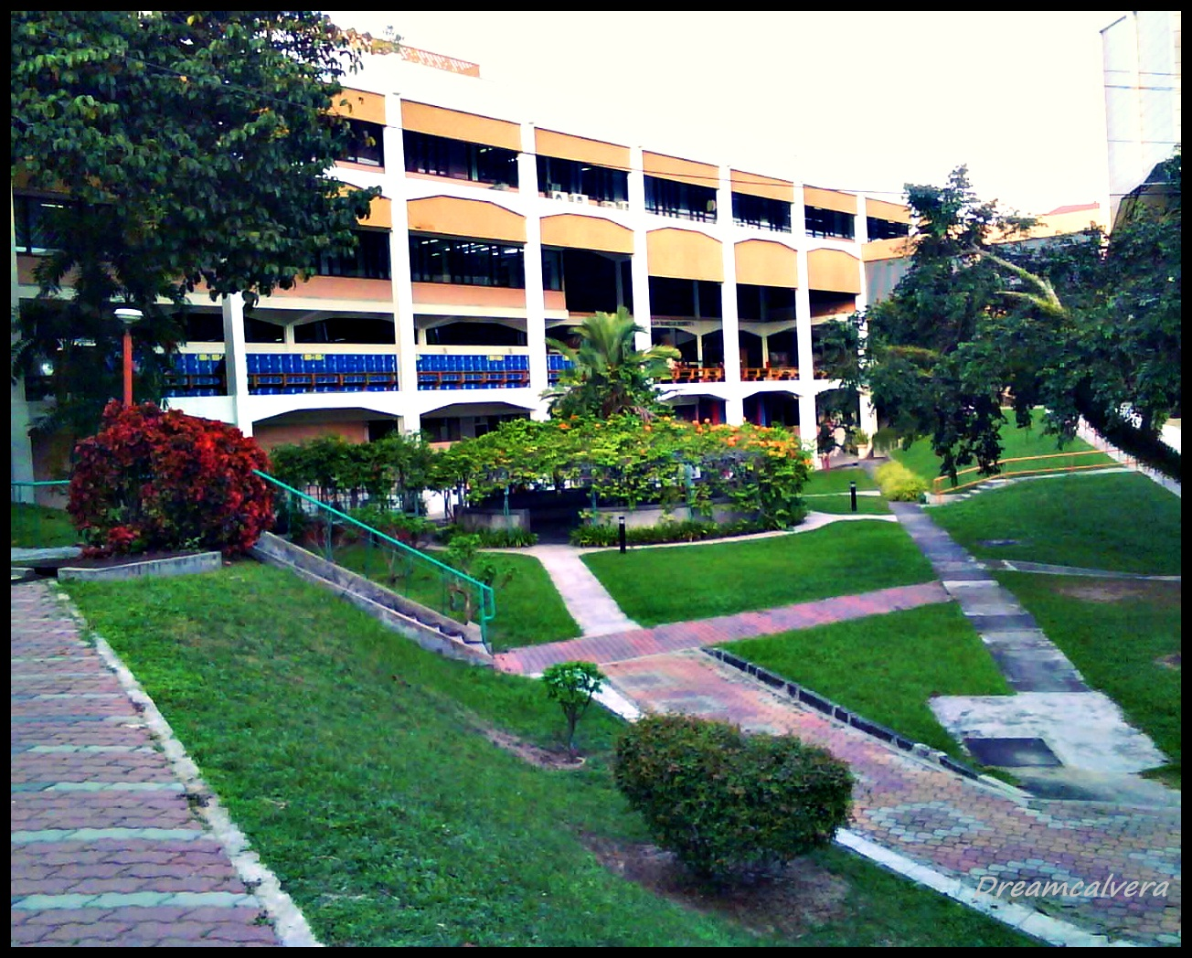
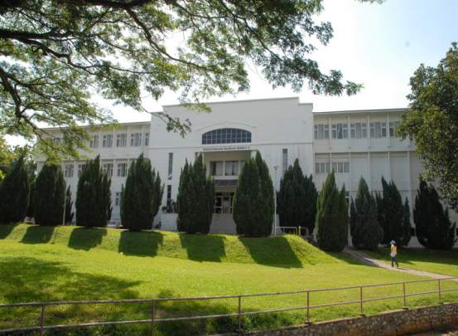
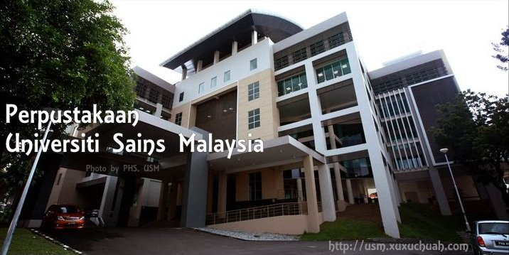
USM libraries
Hamzah Sendut Library 1
Hamzah Sendut Library 2
Hamdan Tahir Library 3 (24hrs)

Slide 16
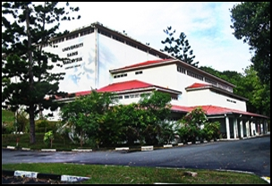
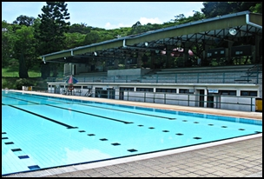
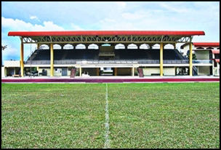
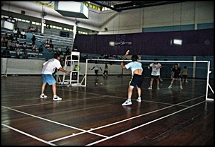
Sports and Recreation Centre
Pusat Sukan
Swimming Pool
Football Field
Badminton court

Slide 17
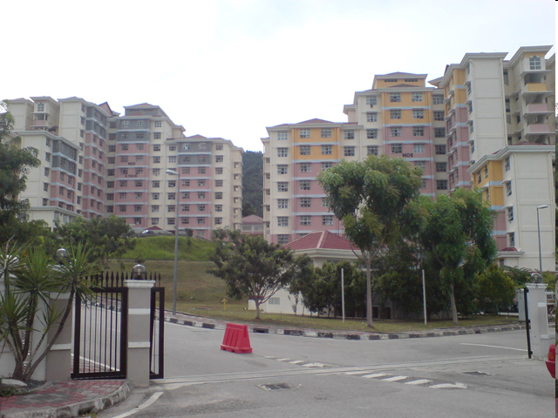
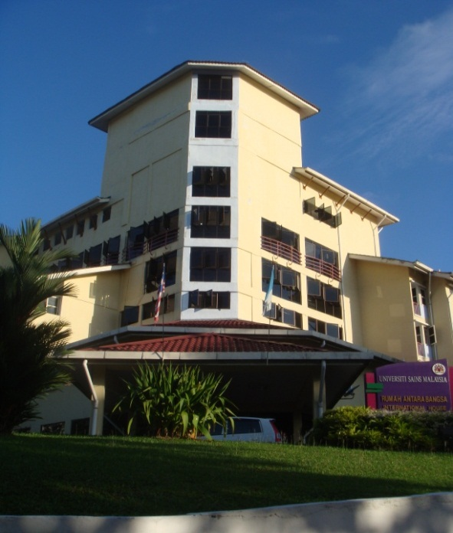
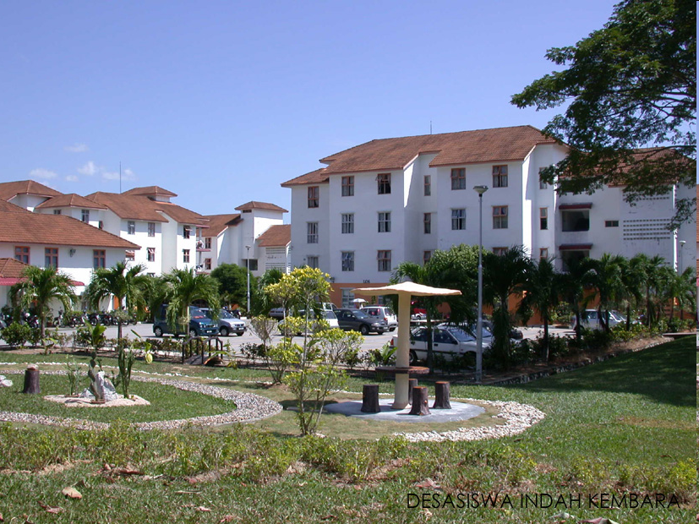
USM Accommodation
Hostels / Desasiswa
Aman Damai
Fajar Harapan
Bakti Permai
Cahaya Gemilang
Indah Kembara
RST – Restu, Tekun, Saujana
International House
PETAS

Slide 18
International Student
Mobility and Internationalization

Slide 19
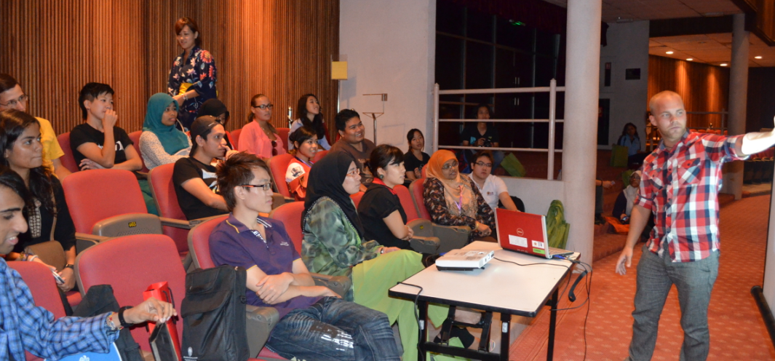
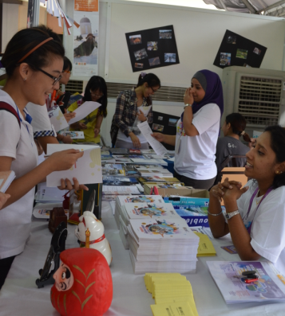
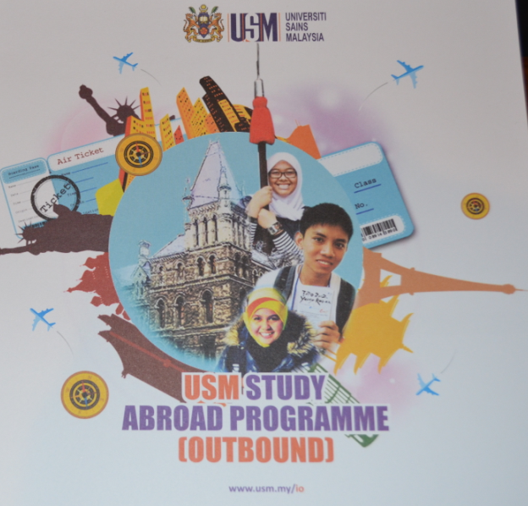

Slide 20
Major Efforts Carried Out by USM for Internationalization and Student Mobility
USM offers exchange programme to students from more than 30 countries and welcomes students to experience living and studying in Malaysia
Coming to USM would allow international students to experience world class education in a great location and discover a nation known throughout the world as being “Truly Asia”

Slide 21
Outbound Programme
International Office is promoting the study abroad programme through:
Series of talks,
sharing experiences by students who have the experiences of joining the study abroad programme,
distribution of pamphlets
personal consultation are given to students who have interest in the programme
USM also provides financial aids to qualified students (flight ticket and some pocket money)

Slide 22
Inbound Programme
International Office is the responsible party in processing all application for inbound programme.
Mutual agreements with partner universities are implemented and USM will receive students for a period of one to two semesters from each university.
Partner universities may send 2 to 8 students per year

Slide 23
Inbound Requirement
There is no minimum requirements for CGPA. We trust our partner universities would select students that are qualified to participate in the Study Abroad @ USM programme.
If English is not the first language of teaching , students are required to fulfill the minimum language requirement as below:
TOEFL : PBT minimum 550 , iPBT = 61 or
IELTS : Band 5 or
Approval letter from School/Faculty of Language notifies that students are able to follow classes in English

Slide 24
Academic Calendar
Dates of Semester 1 and 2
Semester I : 2nd week of September
Semester II : 3rd week of February
14 weeks of classes
1 week of study week
3 weeks of Final Exam

Slide 25
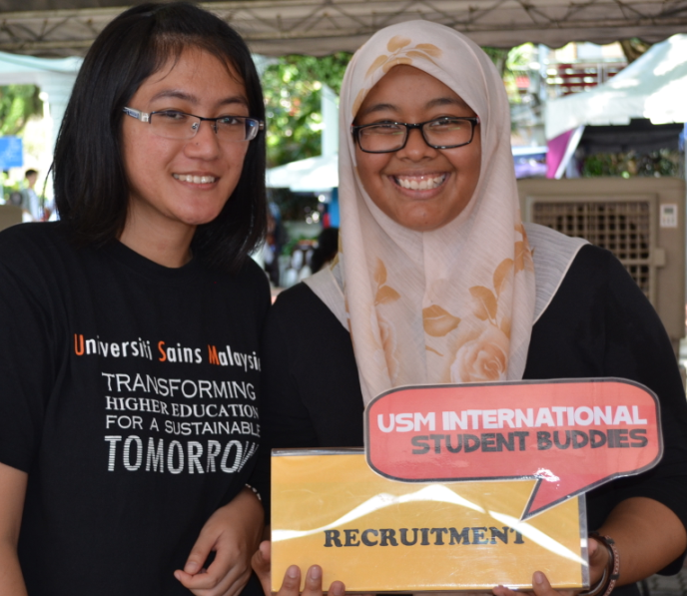
USM Buddies

Slide 26
USM Buddies
This voluntary programme consists of USM students who are helpful and like to be involved in programmes organised by International Office, USM.
They will develop their leadership skills, learn how to practice teamwork when organizing projects and many extra things which hardly gained in the classroom.
USM students who are interested to join the USM Buddies are interviewed and have to go through screening process by joining a few programmmes

Slide 27
Activities for Inbound Students
Orientation Programme
Welcoming speech
Introduction by Buddies & Ice-breaking
Briefings on Visa, Security, Health & Medical, Insurance, Wifi set-up, Library, Courses and Final Exams
Meetings with Schools’ representatives for course registration
Telematch
Library & campus tour
Cultural performances

Slide 28
Activities for Inbound Students
2. Cooking classes
3. Homestay with the village people/foster parents
4. Coffee-hour to learn different languages from other inbound students
5. Gala night/Cultural Fiesta
6. Celebrations in Malaysia: Aidil Fitri, Deepavali, Halloween, Lantern Festival, Chinese New Year, local weddings, etc.

Slide 29
USM Internationalizaztion at Home
At USM, we believe that internationalization should start within USM community.
International Week: Twice annual events involve cultural show, international food exhibition, international games exhibition, cultural talks and international movies.
Norooz/Spring Festival
International Al-Quran Festival
English Camp
Sports tournaments: Badminton,Tennis and Taekwando
Walk for Peace
International Creative Visual Awards
USM-PSU Student Leader Summit
AFLES 2013 (ASEAN Future Leaders Summit)

Slide 30
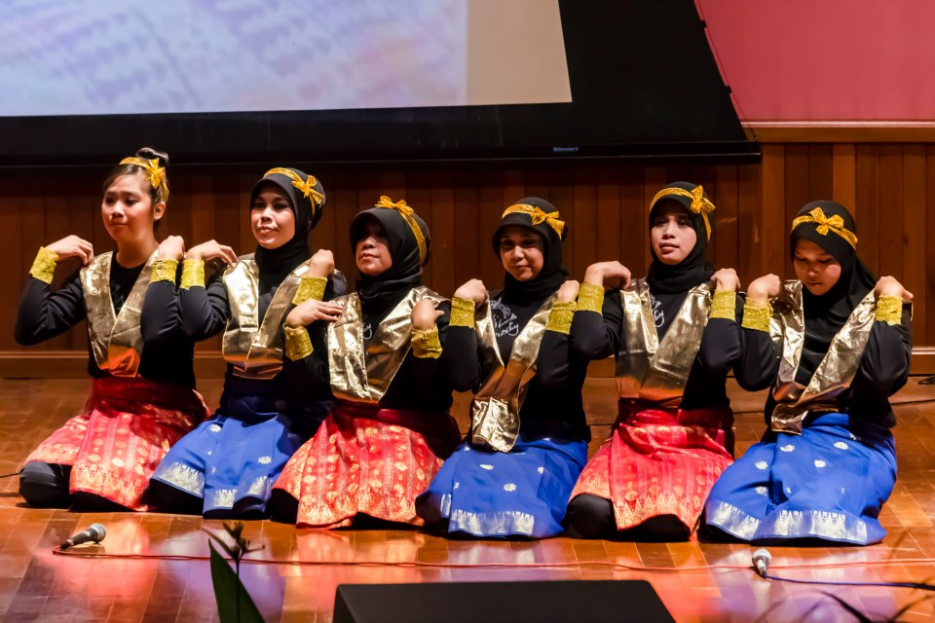
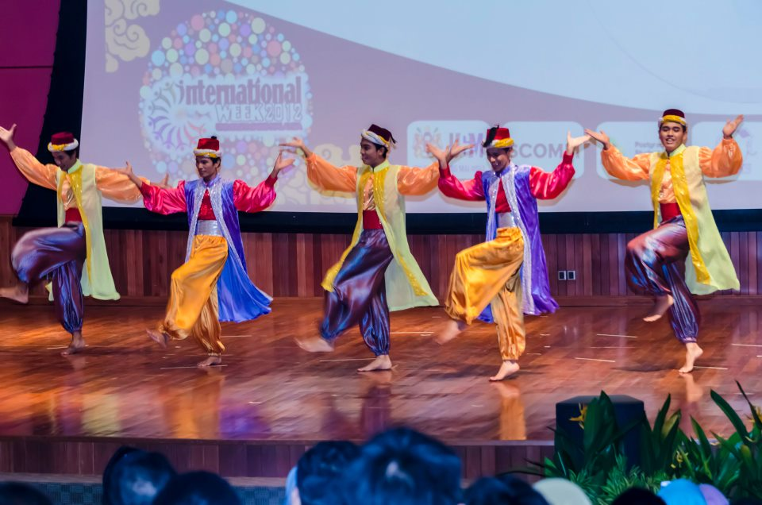
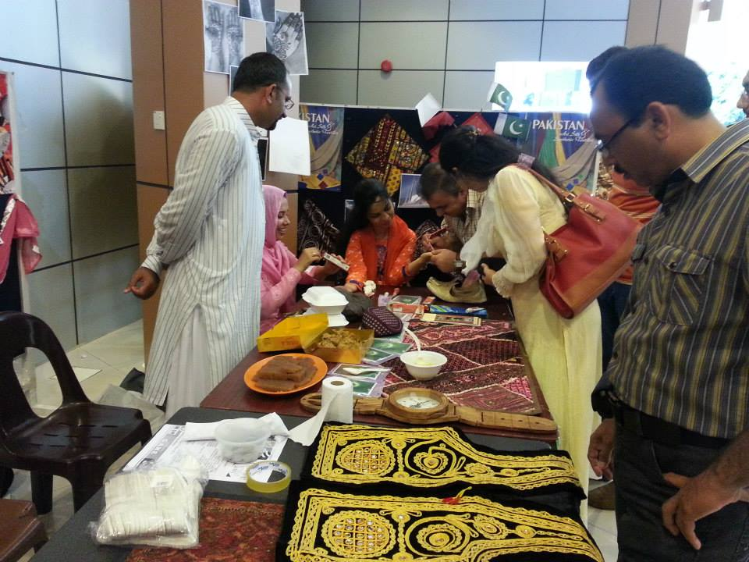
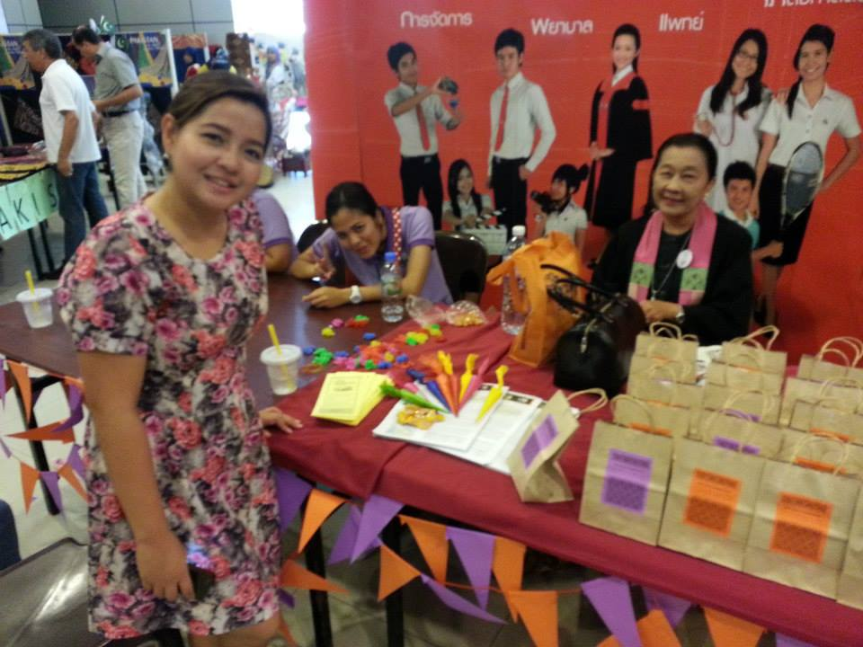
PSA,PETAS & IO Events

Slide 31
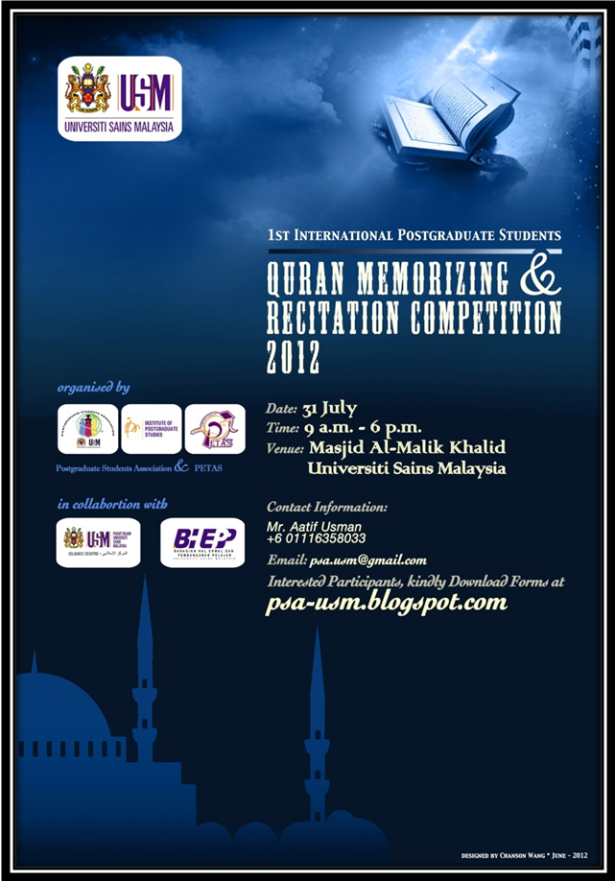
USM Internationalizaztion at Home

Slide 32
USM Internationalizaztion at Home
International Creative Visual Awards: Students from China and ASEAN participate in this short movie and photography competition
USM-PSU Student Leader Summit
AFLES 2013 (ASEAN Future Leaders Summit, Oct 2013)

Slide 33
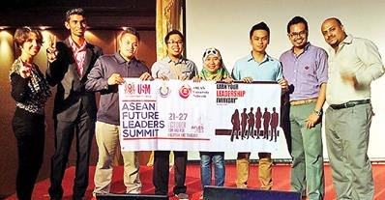
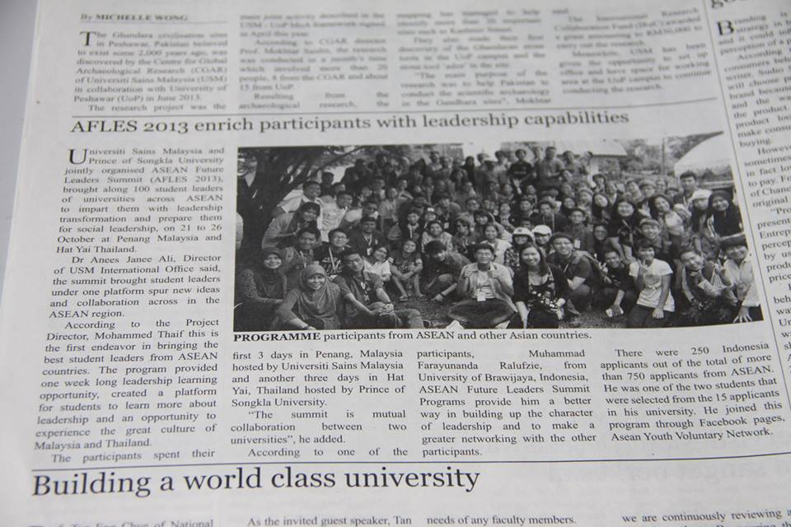
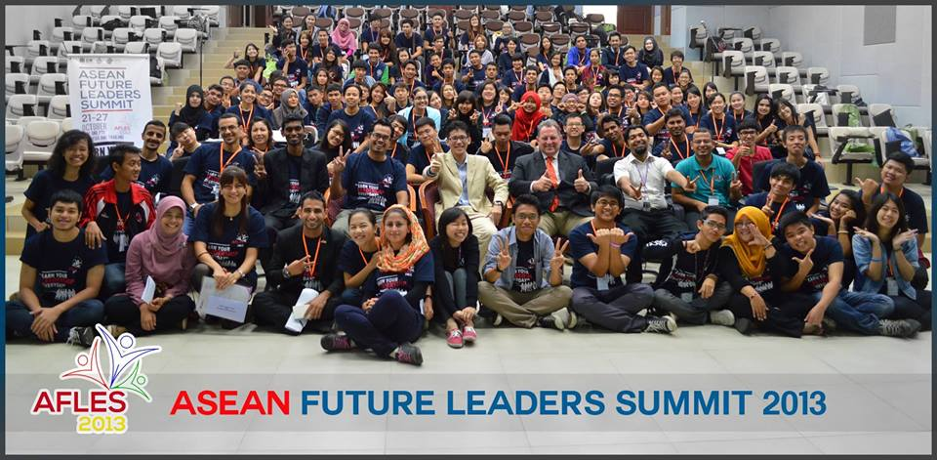
AFLES 2013

Slide 34
USM Internationalizaztion at Home

Slide 35
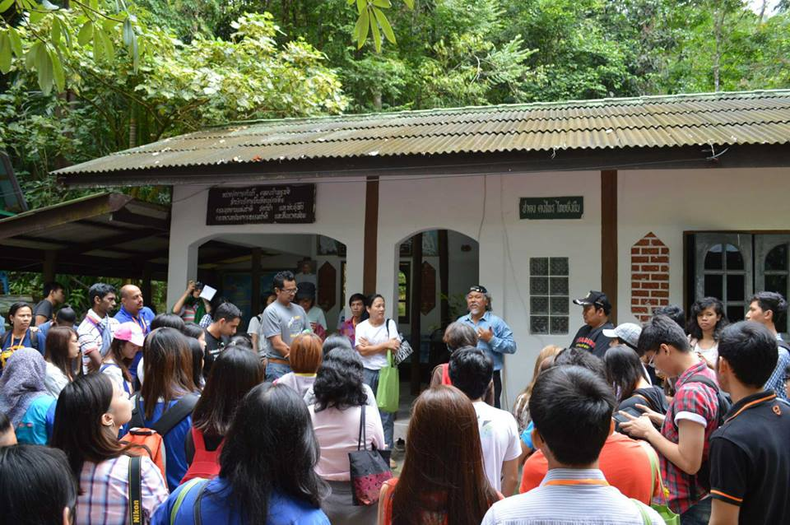
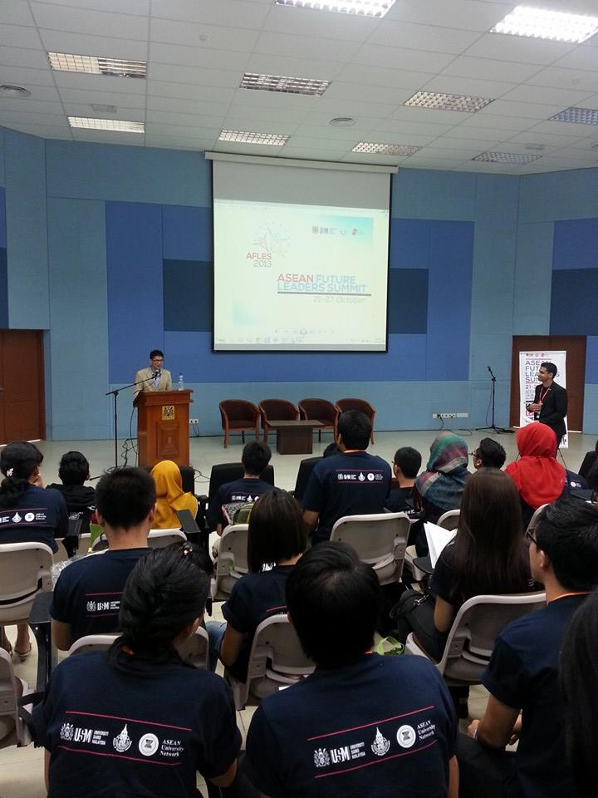
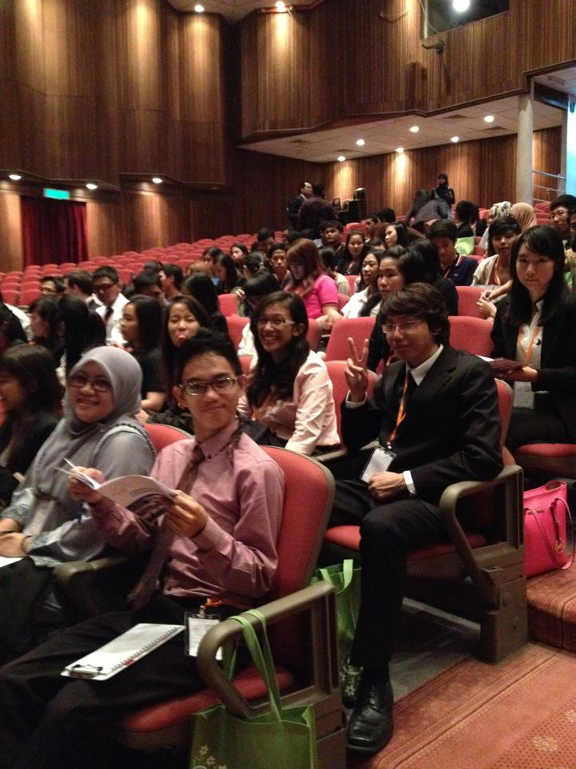
AFLES 2013

Slide 36
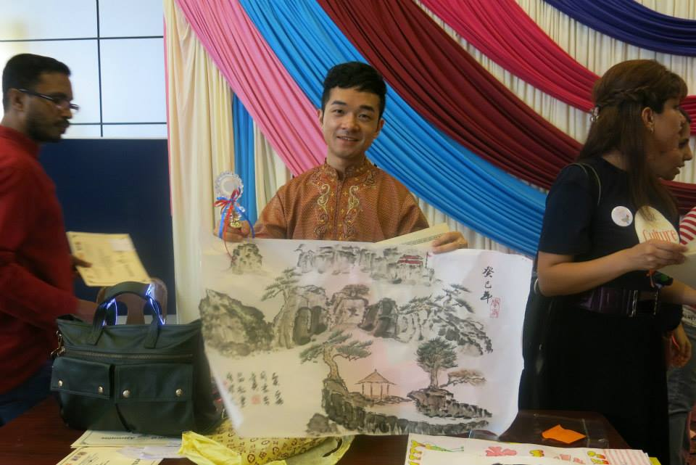
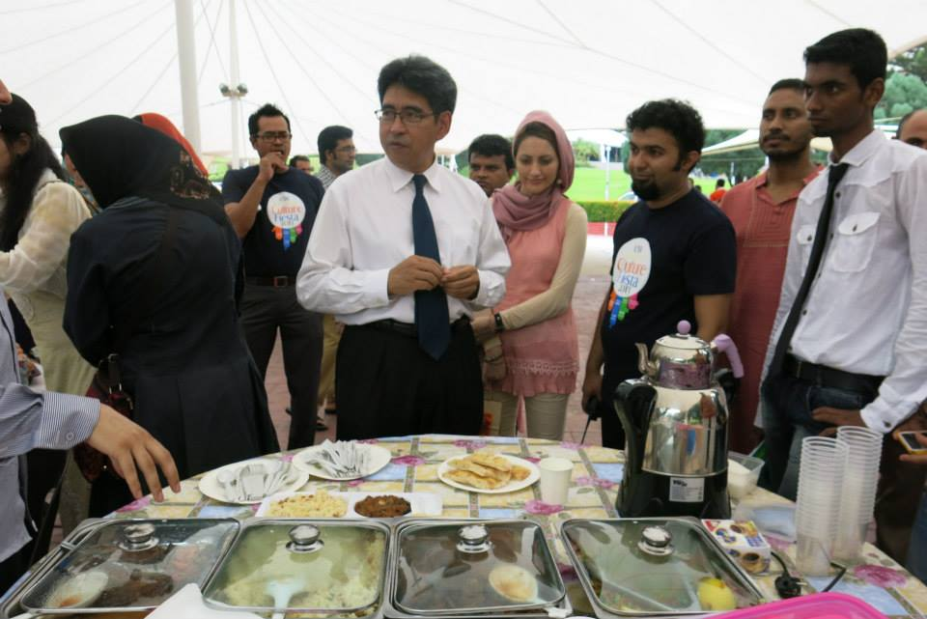
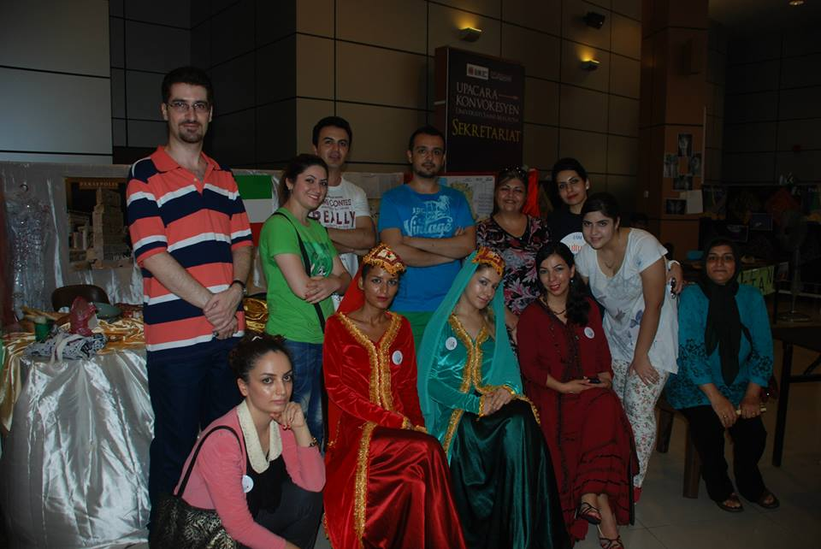
PSA, PETAS & IO Events

Slide 37
PSA, PETAS & IO Events

Slide 38
THANK YOU
ขอบคุณ
Terima Kasih

